Slide 1
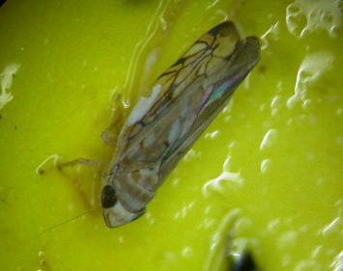
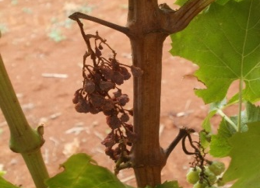
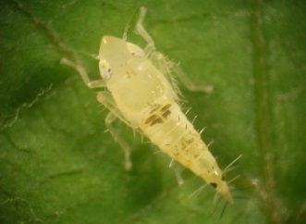
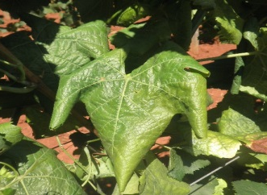
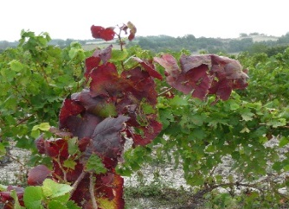
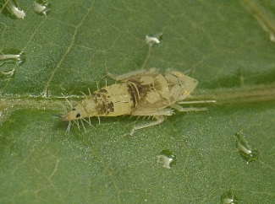
Zlatna žutica vinove loze Važnost monitoringa na širem vinogradarskom području

Slide 2
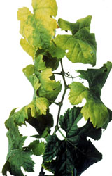
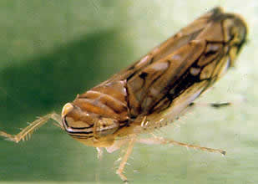
Uvod
Zlatna žutica je po prvi put detektirana 1950-tih godina u Francuskoj
Zaražene trsove je nemoguće izliječiti
Nalazi se na A2 EPPO listi
Za njeno širenje potrebno je istovremena prisutnost fitoplazme (uzročnika bolesti), vektora (američkog cvrčka) i domaćina (loze)
→ U slučaju izostanka suzbijanja, moguće
je njeno brzo širenje, znatni gubici prinosa
te čak propadanje čitavih vinograda
Notes:
The disease, caused by a phytoplasma, which is a quarantined organisms indexed on the A2 EPPO list (n°2009/297CE directive) is one of the most damaging diseases in the European vineyard, with strong economic consequences in the major wine-producing countries. The main known vector of FD is a leafhopper strictly associated with grapevine, who transmits the phytoplasma. FD induce severe impacts, including yield losses and vine plant dieback. Without control measures, the disease spreads rapidly, affecting up to the totality of vines in a few years. Despite mandatory control in Europe for this disease, it is still spreading and requires permanent monitoring to detect new infected areas.

Slide 3
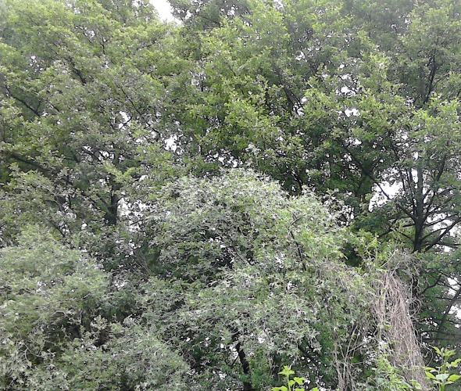
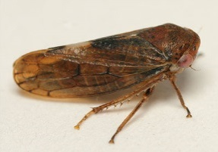
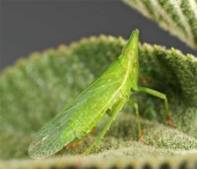
Širenje zlatne žutice
Zlatna žutica se može prenositi s drugih biljnih vrsta na vinovu lozu
Glavni vektor koji prenosi bolest: američki cvrčak (Scaphoideus titanus), koji potječe iz Sjeverne Amerike
Uzročnici fitoplazme:
FD1, FD2 i FD3
Mogući načini širenja
Oncopsis Alni
©Tristan Bantock
Dictyophara europaea
© Dimitri Geystor
Scaphoïdeus titanus
Vitis vinifera
Clematis vitalba i Alnus glutinosa
(obična pavitina i crna joha)
Notes:
FD main known vector, Scaphoideus titanus, was introduced in Europe from North America in the 1950’s. Its introduction was attributed to vine plant introduction from North America.

Slide 4
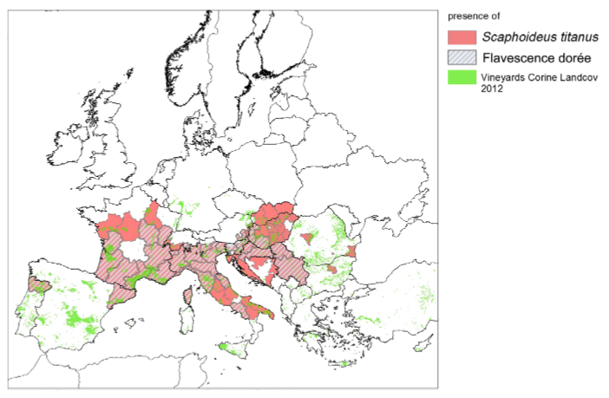
Širenje zlatne žutice
Fitoplazma koja uzrokuje zlatnu žuticu izvorno potječe iz Europe
Američki cvrčak kao vektor zlatne žutice izvorno potječe iz Sjeverne Amerike
→ Područje distribucije američkog cvrčka šire je od područja distribucije zlatne žutice
© EFSA
Notes:
S.titanus may have already been present in 1927, but at such small spatial scale and population level that is was not recorded in inventories. The invasion of European vineyards by S. titanus is an ongoing process, the insect extended from France to most European vineyards and is now widely present in winegrowing regions from West to East from Portugal to Serbia and from North of France to South of Italy. Distribution of S. titanus in Europe is wider than the phytoplasma, insect is present in regions so far safe from FD (e.g. North of Spain or Alsace region in France). The first FD outbreak was detected in France in 1957, and then disease spreads rapidly to other European wine regions. Today the Flavescence Dorée phytoplasma is present the main wine-producing countries in Europe, namely Austria, Croatia, France, Hungary, Italy, Portugal, Slovenia and Spain Switzerland and Serbia. In some of these countries, the phytoplasma is limited to some geographical areas. The spread of the disease in Europe is strongly linked to the spread of Scaphoideus titanus, mainly based on the dispersion of introduced populations and linked to human activities. The spread of Scaphoideus titanus might not be yet ended: populations of S. titanus could become established in northern Europe or China because of favourable climatic conditions of those areas.

Slide 5
Simptomi
U početku vegetacije
Kasno otvaranje pupova
Izostanak otvaranja pupova
Na proljeće
Smanjen porast mladica
Promjena boje lista i savijanje ruba lista kod nekih sorata
Ljeti
Izostanak odrvenjavanja mladica (ostaju zeljaste)
Sušenje (odumiranje) cvatova i grozdova
Prerano opadanje listova
Notes:
Grapevine infected with FD, develops symptoms that are not distinguishable from other grapevine phytoplasmas that belong into the group of grapevine yellows (GY).
Once affected by FD, grapevine shows symptoms characteristics of grapevine yellows. Early vine stages: first visible symptom can be either a delay or lack of budburst, but such observations have always to be completed later by monitoring of typical FD symptoms in summer.
In spring: symptoms of reduced growth of fruiting cane, leaf blade light curling and premature leaf fall can be observed but the more evident symptoms appear later.
In september: On infected grapevine, a lack or absence of lignification in the new shoots can be observed, with leaves curling downwards, cracking when folded in hand, and becoming reddish for red cultivars or yellowish for white cultivars. Desiccation of inflorescences and berries is observed and a premature leaf fall due to limb detachment from petiole can also occur in summer. Inside the plant, phytoplasma reduces photosynthetic activity and nutrient transport, decreasing grape quality or even causing total desiccation of bunches, involving significant yield losses (up to 100%).

Slide 6
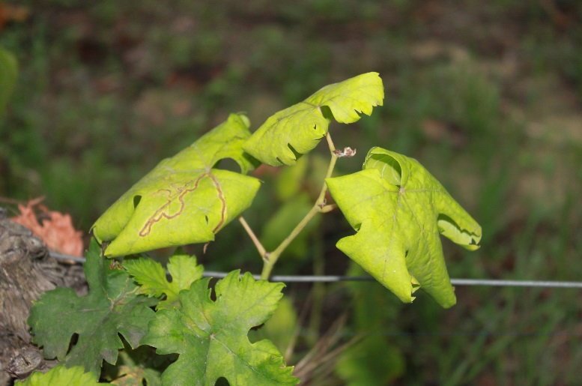
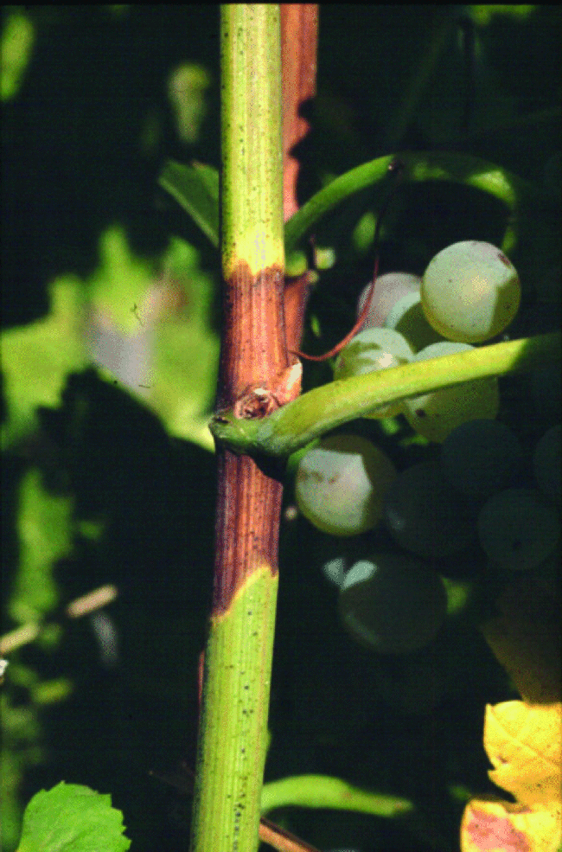
Simptomi
U slučaju sumnje na zlatnu žuticu:
Provjerite javljaju li se na trsu istovremeno sljedeća tri simptoma:
Promjena boje listova (i eventualno uvijanje ruba lista)
Izostanak odrvenjavanja mladica
©Canadian Food Inspection Agency
Sušenje cvatova ili grozdova
Notes:
FD symptoms can be confused with other symptoms, as deficiencies or physiological disorders.
In any case of doubt, the presence of the three typical symptoms (leaf discoloration and curling, no lignification of the shoots and desiccation of bunches) must be checked

Slide 7
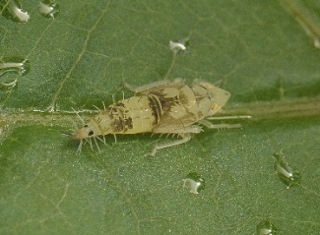
Simptomi
→ Ovisno o sorti, simptomi mogu biti više ili manje izraženi
→ Zaražene podloge mogu biti bez pojave simptoma
Simptomi zlatne žutice ne razlikuju se od simptoma ostalih fitoplazmi vinove loze
→ U slučaju sumnje na zlatnu žuticu, provodi se PCR analiza s ciljem identifikacije fitoplazme
Notes:
Symptoms can be more or less visible according to the cultivar, furthermore, rootstocks are asymptomatic (healthy carriers of FD phytoplasma).
Then laboratory analysis can be performed if a doubt subsists for a FD case. As FD symptoms are similar to Stolbur symptoms, a PCR analysis can determine which phytoplasma is responsible for the observed symptoms. PCR method allow to diagnose and identify phytoplasma inside grapevine organs (leaf blade and petiole) by analysing DNA fragment

Slide 8
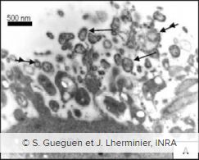
Tri čimbenika potrebna za širenje zlatne žutice
Uzročnik bolesti: fitoplazme skupine FD1, FD2 ili FD3
Fitoplazma je mikroorganizam sličan bakteriji, nema staničnu stijenku i nastanjuje floem biljke → prenosi se vektorom ili reznicama
3 skupine fitoplazmi uzrokuju zlatnu žuticu:
FD1 – najzastupljenija na jugu Francuske
FD2 – glavna skupina u Europi
FD3 – prisutna uglavnom u Italiji
Ostale biljne vrste domaćini: obična pavitina i crna joha
Fitoplazma
Notes:
The phytoplasma causing FD show genetic diversity: several phytoplasma strains can cause FD and are distributed throughout Europe. Till now, 3 genetics groups of FD phytoplasma are identified in Europe
Host-plants can serve as phytoplasma reservoirs, as Alnus glutinosa, Clematis vitalba and wild Vitis species. In Europe, the mainly accepted hypothesis is that those FD-related phytoplasma were hosted in those plants prior to grapevine.

Slide 9
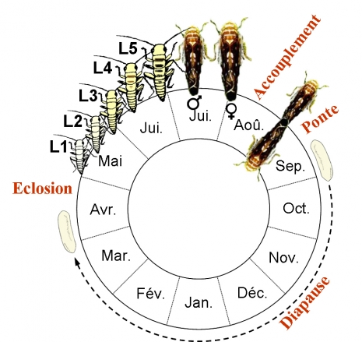
Tri čimbenika potrebna za širenje zlatne žutice
2) Vektor: američki cvrčak (Scaphoideus titanus )
Životni ciklus
Jedna generacija godišnje
Ličinke obično ostaju na trsu nakon izlaska iz jajeta
Odrasli oblici su mobilni i lete s trsa na trs
Parenje
Leženje jaja
Izlazak iz jajeta
Mirovanje
©Cuche
Notes:
Scaphoideus titanus is a univoltine species.
Eggs are laid in late summer under the bark of old wood, then after a diapause stage of 6 to 8 month depending on climatic conditions and vineyard characteristics, eggs hatch. Hatching period duration is related to diapause, which does not require cold temperatures to break.
Hatching period duration is varying according to the regions and long hatching periods are typical of vineyards with mild winters. Temperatures regulate the beginning and the length of hatching period as well as the sex ratio. After hatching, 5 nymphal instars follow each other in 5 to 8 weeks according to climatic conditions before adult appearance. Nymphs usually stay on the plant where they hatch but sometimes jump from one plant to another. They feed preferentially on suckers at the basis of the trunk or on the lower and inner leaves. Adults appear generally from July, are highly mobiles and fly from vine to vine. In order to mate, Scaphoideus titanus emits vibratory communication signals. Females, if mated, are able to start laying eggs 10 days after emergence (maturity at 6 days after emergence).

Slide 10
Tri čimbenika potrebna za širenje zlatne žutice
2) Vektor: američki cvrčak (Scaphoideus titanus )
Hranjenje
Ima usni ustroj za bodenje i sisanje i hrani se na listu loze
Usvajanje fitoplazme u tijelo američkog cvrčka moguće je od prvog razvojnog stadija ličinke
Zatim slijedi period inkubacije koji traje mjesec dana, nakon čega je cvrčak infektivan do kraja života
Notes:
Scaphoideus titanus feeds on grapevine leaves. It is generally admitted that Scaphoideus titanus is mostly feeding in the phloem vessels, but it can probe sap either in the phloem or in the xylem. Nymph prefer to feed on small veins of the leaf blade and adults feed more on the larger veins or petioles. From the first nymphal instar, S. titanus can acquire the phytoplasma when feeding on infected plants, and then remain infected for the rest of its life. An incubation delay of one month is required for the vector to become infectious. During this period the phytoplasma circulates and multiplies in the leafhopper to reach the salivary glands where multiplication rate is even higher. Once the concentration of phytoplasma in the salivary glands is sufficient, the infectious agent may be transmitted to a healthy plant for every intake.

Slide 11
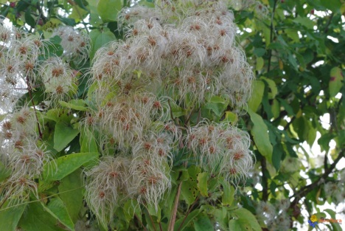
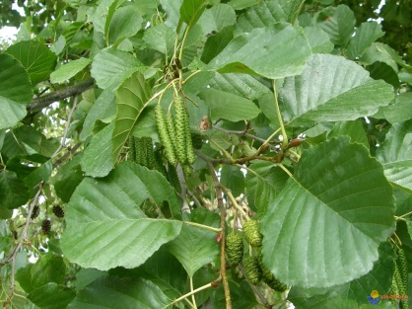
Tri čimbenika potrebna za širenje zlatne žutice
3) Biljka domaćin: vinova loza i ostale vrsta loza
Američki cvrčak može svoj cjelokupni životni ciklus dovršiti jedino na vinovoj lozi
→ zlatna žutica je bolest koja se širi epidemijski
Zlatna žutica je prisutna i na drugim biljnim vrstama: Clematis vitalba (obična pavitina) i Alnus glutinosa (crna joha)
→ I ostali vektori mogu prenositi zlatnu žuticu (Oncopsis alni i Dictyophara europaea), ali je takvo širenje od minornog značaja.
Oncopsis alni
©Tristan Bantock
Dictyophara europaea
© Dimitri Geystor
Clématis vitalba
© Visoflora
Alnus glutinosa
© Visoflora
Notes:
In Europe, S. titanus is strongly associated to Vitis vinifera but can be occasionally found on other plants as Salix viminalis and Prunus persica. The insect accomplish its entire life cycle on grapevine but can occasionally feed on other plants. S. titanus could have varietal preferences: in multivarietal vineyard different population level were observed on each variety.
S. titanus is associated to grapevine but FD phytoplasma can be found in other species as Alnus glutinosa, Clematis vitalba, Ailanthus altissima... Other vector species, as the planthopper Dictyophara europaea and the leafhopper Oncopsis alni, can transmit the phytoplasma from these species to grapevine. But this phenomenon seems very occasional, then transmission probability is low as these vectors are very rare feeders on grapevine unlike S. titanus
When a vine plant is infected, phytoplasma colonizes all the parts of the plant via the phloem and constitutes therefore a source of infection. By feeding on grapevine and moving from grapevine to grapevine, S. titanus spread the disease. Therefore, the infection rate in year N is strongly correlated to vector populations in year N-1. Without insecticide treatment, S. titanus populations in vineyard can reach a magnitude range of thousands of individuals per hectare leading to a fast spread of the disease, with an increasing number of infected vines up to 10-fold every year!

Slide 12
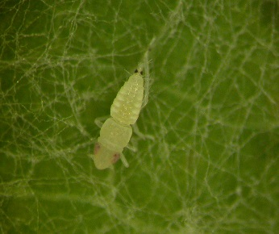
Monitoring zlatne žutice
Prepoznavanje američkog cvrčka
Ima dvije simetrične crne točke na dorzo-lateralnoj poziciji
Stadiji razvoja ličinke: L1 (lijevo), L3 (u sredini) i L5 (desno)
Odrasli oblik:
Smeđe boje
Duljine od 4,8 do 5,8 mm
Scaphoideus titanus
Notes:
Scaphoideus titanus is hard to detect and to recognize, because nymphs are small and mobiles.
Furthermore, the leafhopper can be confused with other leafhoppers or insects living on grapevine.
Early stages of S.titanus nymphs are first white colour to translucent, and then stain with ageing. Nymphs are identifiable thanks to two symmetrical black points in dorsolateral position near abdomen posterior end. Nymphs, when disturbed, show a typical behaviour: they tend to jump away. This behaviour can be used to discriminate S.titanus nymphs from other leafhopper juvenile forms that should be present at the same time on the grapevine leaves, such as Empoasca vitis (when disturbed moves laterally on the leaf surface) and Zygina rhamni (when disturbed show to move along a straight line on the leaf surface).
Scaphoideus titanus adult size range from 4,8 to 5,8 mm, has brown colour and stripes on the head.

Slide 13
Monitoring zlatne žutice
Prepoznavanje američkog cvrčka
S ponešto iskustva američkog cvrčka je moguće prepoznati na trsu već od prvog razvojnog stadija ličinke
Za prve razvojne stadije potrebno je pregledati 100 do 200 listova na mladicama na deblu i na bazalnim listovima
Žute ljepljive ploče koriste se za ulov
odraslih oblika u vinogradu ili
u blizini zapuštenih loza
Žuta ljepljiva ploča (IFV)
Notes:
Monitoring the vector is helpful to detect any new presence of S. titanus. Monitoring can start on S.titanus nymphs but requires trained technicians. To be precise enough, visual control should be performed on 100 to 200 leaves underside and on grapevine basal shoots and leaves avoiding moving excessively the vegetation because the leafhopper jump away. Finding Scaphoideus titanus does not mean that there is FD in the area but mean that there is a risk for future FD outbreak. The plot needs to be monitored during the season and insecticides treatments can be applied as preventive measure to prevent infection.
Monitoring of S.titanus can be done more easily on adults by positioning sticky traps in the vineyard, inside plots and close to areas with wild vines.
Monitoring FD vector can help to prevent FD infection and in a case of infection to take necessary measure rapidly. In vine areas close to winegrowing regions with confirmed presence of Flavescence Dorée disease, monitoring vectors is highly significant.

Slide 14
Monitoring zlatne žutice
Nova zaraza zlatnom žuticom u području koje još nije zaraženo može se spriječiti suzbijanjem potencijalnih izvora zaraze:
Potencijalni izvori zaraze: divlja loza, zapušteni trsovi i ostale biljne vrste poput obične pavitine i crne johe:
Ove biljke predstavljaju rizik epidemijskog širenja
Također su važne u smislu očuvanja bioraznolikosti ekosustava
→ Djelovati u skladu sa situacijom i procjenom rizika
Notes:
Wild vines and other species represent a reservoir for Scaphoideus titanus, and for FD phytoplasma. FD phytoplasma has been reported on wild species as Clematis and Alnus and may be transmitted occasionally to grapevine.
This so-called “wild compartment” thus presents a known risk of epidemic emergences. However, he could also supply services at the vineyard: reservoir of biodiversity, natural regulation of some pests by auxiliaries. Thus, it’s important to consider and estimate the relationships between epidemic risk and services of natural regulation which offer these semi-natural areas. So, beyond the perimeter of the vineyard itself, the extension of the monitoring and disease control in these wild compartments is not easy.

Slide 15
Monitoring zlatne žutice
Monitoring šireg vinogradarskog područja
Tiče se svih vinogradara → po tom pitanju bitan je kolektivan monitoring na širem području
Kod sumnje na zarazu potrebno je kontaktirati fitosanitarnog inspektora → kako bi se potvrdila eventualna zaraza i kako bi se ta informacija službeno objavila
Fitoplazma se utvrđuje laboratorijskom analizom
Notes:
objective of monitoring : to inventory the sanitary status of vineyards and agricultural fields and to monitor appearance and spread of new harmful organisms.
Control of visible symptoms on Vitis vinifera cultivars has to be implemented at the vineyard scale, by winegrowers on their own vineyard or at larger scale for a regional vineyard with collective prospecting. It is important that all stakeholders of the vine and wine sector are involved in monitoring and are aware of damages caused by Flavescence Dorée. Areas without FD need to be protected from infection and monitoring is a major key to prevent outbreaks.
Winegrowers need to be trained on symptoms recognition as well as specialized technicians who will monitor territory at a large scale. Where FD is known for present, a dedicated plan could organize the monitoring of the territory paying a specific attention to rootstocks as those can carry FD phytoplasma without showing any symptom.
In case of FD introduction in new areas, previously marked as uninfected, control and eradication measures must be applied in correspondence with European, national and regional laws. Indeed, as a result of the FD quarantine status, report of symptomatic plants potentially infected with Flavescence Dorée phytoplasma is mandatory in every winegrowing region of Europe.
Collection and analysis of symptomatic grapevines samples can complete visual observations and is the only way to distinguish FD phytoplasma from Stolbur phytoplasma.
Who to inform in case of symptoms detection?
If FD symptoms are detected in a vineyard area, local technicians should be asked to confirm the potential FD case before reporting to official authorities.
How to be sure?
FD and Stolbur are expressing similar symptoms on vine. In order to distinguish between those two diseases, and even from other possible confusing causes of the observed symptoms, an analysis has to be performed in accredited labs.
Who to inform in case of vector introduction?
If vector is detected in a vineyard area, an entomologist or specialized technician should be asked to confirm the leafhopper species before reporting to official authorities.

Slide 16
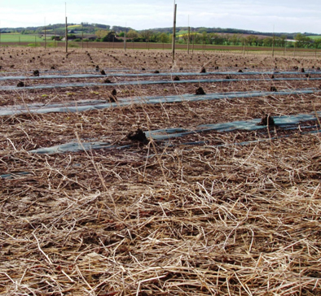
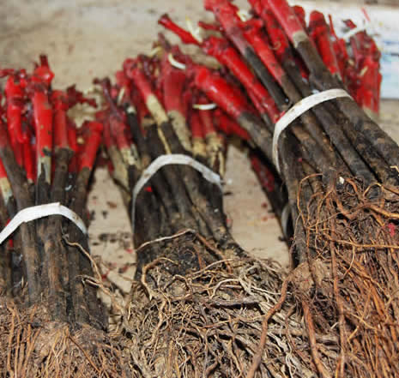
Korištenje nezaraženog sadnog materijala
Tri mogućnosti širenja bolesti:
Sadnja zaraženog sadnog materijala
Prijenos ili let zaraženog cvrčka
Prijenos na lozu s ostalih (zaraženih) domaćina
Rasadnici:
→ Potrebno je vršiti temeljiti monitoring matičnih nasada
→ Cijepovi se mogu tretirati toplom vodom s ciljem suzbijanja eventualne zaraze
Notes:
In areas free from FD nurseries can implement special activities to prevent FD phytoplasma infection as hot water treatment and a conscientious monitoring of mother-vines.
In Europe, according to the country or region, there are specific rules regarding nurseries as mandatory hot water treatment, and, in some cases, prohibition to manage nursery activity in FD outbreak regions.
Management in nurseries
In nursery, monitoring should be focused in controlling symptoms development on the mother plants, both mother plants of rootstocks (healthy carriers) and scions by regular observations. Any symptomatic plants should be registered and uprooted. In case of detection, local competent authorities should be informed. Flavescence Dorée vector, S.titanus should be also monitored on mother-vines by preventive nymphs and adult monitoring. Furthermore, diagnosis tools of phytoplasma detection should be implemented.
Hot water treatment
Hot water treatment (HWT) allows the eradication of the FD phytoplasma from propagation material and can be used to prevent infected material to enter the area. Hot water treatment need to be applied on scions or grafted rootlings in controlled conditions: plants are immerged in a bath of hot water for 45 minutes at 50°C. Combination of time and temperature is the most important factor in HWT efficiency and need to be such as suppress phytoplasmas without affecting vine development. If combination of 50°C for 45 minutes is not respected, buds can present localized cellular degeneration and total alteration up to 60°C.
Purchasing hot water treated material is strongly recommended to European growers, in particular for regions where FD is not present yet. In presence of the vector, a single infected plant can generate a wide infection.

Slide 17
Zaključci
Zlatna žutica je bolest koja se može brzo širiti, pritom uzrokujući znatne ekonomske gubitke
U nekim vinogradarskim područjima zaraze još uvijek nema, zbog čega je redoviti monitoring od ključnog značaja kako bi se eventualna nova zaraza pravovremeno utvrdila
Podizanje svijesti i uključivanje svih dionika iz sektora je ključno s ciljem provedbe kvalitetnog monitoringa i sprječavanja širenja zlatne žutice
Notes:
Flavescence Dorée is a serious disease, and if not properly managed spreads rapidly and causes important economic losses for the wine sector. In Europe, areas spared from FD remain. But the vector is spreading fast and with it the disease. In regions free from FD, monitoring vineyard is essential to prevent introduction of Flavescence Dorée vector. In the presence of the vector, a single infected plant can generate a wide infection. Raising awareness of sector’s stakeholders is important in the prevention of FD outbreaks, by education on diseases epidemiology, symptoms and risks.

